Slide 1
Lecture
Computer Security
Ports, Firewalls, Passwords, and Malware

Slide 2
Security Measures
Firewalls
Passwords
Mal-Ware
Anti-Virus and Anti-Spy-Ware
Patches and Upgrades

Slide 3
Understanding Ports
A port is a doorway to a connection in the Internet world.
Part of TCP/IP layer –65,535 possible ports
Different layers of TCP/IP use different ports, eg:
Port 80 for web traffic
Port 21 for FTP
Port 25 for email
Port Table

Slide 4
Port Scanning & Malicious Probes
It is similar to a thief going through your neighborhood and checking every door and window on each house to see which ones are open and which ones are locked.
Port scanning software sends out a request to each port sequentially and makes a note of which ports responded or seem open to more in-depth probing.

Slide 5
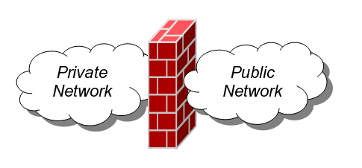
Firewalls
Firewalls provide protection against outside attackers by shielding your computer or network from malicious or unnecessary Internet
Firewalls can be configured to block data from certain locations while allowing the relevant and necessary data through
Firewalls can either be hardware and/or software based.
Notes:
A firewall is a dedicated appliance, or software running on another computer, which inspects network traffic passing through it, and denies or permits passage based on a set of rules.
A firewall's basic task is to regulate some of the flow of traffic between computer networks of different trust levels. Typical examples are the Internet which is a zone with no trust and an internal network which is a zone of higher trust. A zone with an intermediate trust level, situated between the Internet and a trusted internal network, is often referred to as a "perimeter network" or Demilitarized zone (DMZ).
A firewall's function within a network is similar to firewalls with fire doors in building construction. In the former case, it is used to prevent network intrusion to the private network. In the latter case, it is intended to contain and delay structural fire from spreading to adjacent structures.
Without proper configuration, a firewall can often become worthless. Standard security practices dictate a "default-deny" firewall ruleset, in which the only network connections which are allowed are the ones that have been explicitly allowed. Unfortunately, such a configuration requires detailed understanding of the network applications and endpoints required for the organization's day-to-day operation. Many businesses lack such understanding, and therefore implement a "default-allow" ruleset, in which all traffic is allowed unless it has been specifically blocked. This configuration makes inadvertent network connections and system compromise much more likely.

Slide 6
Firewalls
Windows & Apple have a built in firewall
Some anti-virus software provide firewall
Blocks traffic based on...
  Content
  User
  Patterns
  Ports

Slide 7

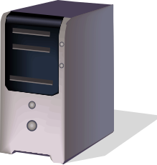
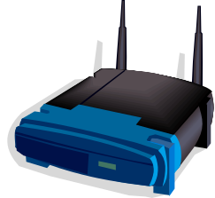
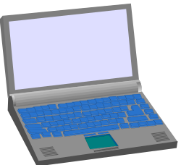

The Big Picture
Internet
Network
Switch
Firewall
DSL Modem
)))
DSL Modem

Slide 8
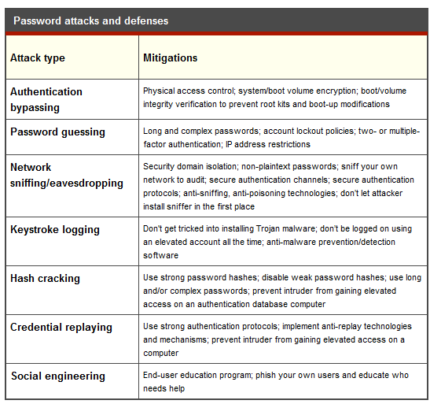
Password Attacks
Notes:
The most popular password attacks include authentication bypassing; guessing; network sniffing or eavesdropping; keystroke logging; hash cracking; credential replaying; and social engineering.
Authentication bypassing
This attack entails simply hacking around the authentication check. A common example: A would-be hacker uses a separate boot disc with the ability to read the targeted data partitions so as to bypass the normal log-on prompts and access the data directly. Another example would be an attacker using a remote buffer overflow (or SQL injection, and so on) against a running application or service to gain unauthorized access to the data.
Password guessing
Here, an attacker attempts to guess a user's password by making multiple (sometimes thousands or millions) log-on attempts using proposed passwords against some sort of log-on prompt. Common guessing locations include the normal log-on prompt, Web-based e-mail, FTP, and remote management consoles
Password sniffing
This attack is launched by installing a network protocol analyzer (a sniffer) on the network communication's path between the authentication client and the server containing the authentication database. Even if the network is a 100 percent switched, "poisoning" the switch into hub mode or sniffing at an aggregation point it isn't nearly as hard as most people think. Either way, any plaintext log-on credentials can easily be picked up. Most networks have more plaintext passwords flying around than admins know -- or want to know. This attack is particularly dangerous in that it does not require elevated privileges and can be "silently" implemented.
Keystroke logging
Here, a hacker compromises a computer with a keystroke-logging malware program, which records log-on credentials as the end-user types them in. The keylogger stores the captured keystrokes for pickup or sends them to the remote hacker. Installing a keystroke logger usually (although not always) requires elevated permissions and privileges.
Hash cracking
This form of attack necessitates elevated credentials (administrator or root) or performing an authentication bypass attack to access the credential database. Once the attacked accesses the authentication database, he or she can be query it to cough up the stored password hashes; most passwords are stored using their hashed derivatives instead of plaintext to complicate unauthorized recovery. Depending on multiple variables, such as password length, hash algorithm used, salting, and so on, converting the hash to its plaintext equivalent can be easy or hard. Unfortunately, it's often very easy once the hash is obtained.
Credential replaying
This technique requires the attacker to first obtain log-on credentials, such as password hash, which he or she then uses to replay across the network to access otherwise unauthorized resources. The pass-the-hash attack is a great example.
Social engineering
Forget all the technical stuff: A bad guy can just ask an end-user for his or her password in person, over the phone, or ever more popular, through phishing e-mails or convincing-looking fake Web sites. Getting a user's password is far easier than it should be. It's nearly child's play.
The best protection of all is a strong password policy, which can complicate many of the attacks. A strong password policy includes a decent minimum password length (say, a 10- to 12-character minimum), enforced complexity, prevention of password re-use, and forced password changes (say, every 45 to 90 days as a maximum life). If your password policy doesn't have these minimum recommendations, it isn't considered strong.
Reducing the amount of software and services running on a computer will give an intruder less software to compromise to get around authentication protections. All software, OS and otherwise, should be fully security patched. When software or an end-user is logged on, it should be running with nonelevated privileges whenever possible.
Security domain isolation, in which computers and networks are insolated in what they can see of each other, will prevent intruders from one host or network from easily compromising other hosts and networks. For example, if an attacker compromises a network and installs a sniffer, if the network traffic can never be rerouted to the attacker's site, the password credentials cannot be pulled off the wire. In another example, if the attacker compromises an authentication database on one server, he or she can't immediately use it to compromise another. In most instances, most servers don't need to access other servers. Workstations don't normally need to access other workstations unless there is a workstation-level file or printer share. and the average workstation doesn't need to access every server -- so don't let them. You can use IPSec, firewalls, VLANs, or access control lists to enforce security domains.
Lastly, minimize password re-use between security domains. Attackers love when users and admins re-use their now compromised passwords between separate and distinct security domains.
All these protections will make any of the password attacks harder to pull off, but the following table lists some of the specific mitigations that can be used against specific attack types

Slide 9
Password Tips
Character Length
Complexity
Case, Symbols, and Numbers
Sharing with Others
Changing
Uniqueness
Tips

Slide 10
Web-based Exploits
More common now than sending malicious email attachments
Botnets: Networks of infected PCs inject code into legitimate websites
Download codes stealthily to innocent users READ “A day in the life of a hacker”
Harvest keystrokes and financial data
Example: Business Week.com infected 2007

Slide 11
HTML and SQL injections
Limbo malware – Costs $300
Trojan Horse programming
Downloaded via pop up or phishing
Adds extra fields to legitimate online banking and financial sites
Tricking users into giving up bank numbers, pins, SSN’s numbers and valuable information

Slide 12
Phishing Scams
Identity theft –asks for personal information or account information
Increase “click count” – encourages you to click on a link… to surreptitiously increase “click count” revenue.
Gateway to malware - clicking on a link in a phishing email may trigger the launch of malware.
Was that a no-no? - clicking on the link may take you to site that looks perfectly OK… except that malware is launched in the background
Notes:
In computing, phishing is the criminally fraudulent process of attempting to acquire sensitive information such as usernames, passwords and credit card details, by masquerading as a trustworthy entity in an electronic communication. Communications purporting to be from PayPal, eBay, Youtube or online banks are commonly used to lure the unsuspecting. Phishing is typically carried out by e-mail or instant messaging,^{[1]} and it often directs users to enter details at a website. Phishing is an example of social engineering techniques used to fool users.^{[2]} Attempts to deal with the growing number of reported phishing incidents include legislation, user training, public awareness, and technical security measures.
A phishing technique was described in detail in 1987, and the first recorded use of the term "phishing" was made in 1996. The term is a variant of fishing,^{[3]} probably influenced by phreaking,^{[4][5]} and alludes to baits used to "catch" financial information and passwords.

Slide 13
Spy-Ware
Degrades PC/internet performance
Browser Hijacking
Anti-Spyware software:
  Ad-Aware by Lavasoft
  Grisoft's AVG Anti-Spyware 7.5,
  Microsoft's Windows Defender 1.1 (free)
  Safer Networking's Spybot Search & Destroy
  Webroot's Spy Sweeper 5.5-Vista
Notes:
Spyware is computer software that is installed surreptitiously on a personal computer to intercept or take partial control over the user's interaction with the computer, without the user's informed consent.
While the term spyware suggests software that secretly monitors the user's behavior, the functions of spyware extend well beyond simple monitoring. Spyware programs can collect various types of personal information, such as Internet surfing habit, sites that have been visited, but can also interfere with user control of the computer in other ways, such as installing additional software, redirecting Web browser activity, accessing websites blindly that will cause more harmful viruses, or diverting advertising revenue to a third party. Spyware can even change computer settings, resulting in slow connection speeds, different home pages, and loss of Internet or other programs. In an attempt to increase the understanding of spyware, a more formal classification of its included software types is captured under the term privacy-invasive software.
In response to the emergence of spyware, a small industry has sprung up dealing in anti-spyware software. Running anti-spyware software has become a widely recognized element of computer security best practices for Microsoft Windows desktop computers. A number of jurisdictions have passed anti-spyware laws, which usually target any software that is surreptitiously installed to control a user's computer

Slide 14
Anti-Virus Software
Searches all drives looking for known "virus signatures"
Scans all files and email attachments as they are accessed
Virus Definition Files must be updated frequently (daily or better)
Symantec Anti-Virus
  Licensed for campus and home
Notes:
Antivirus software are computer programs that attempt to identify, neutralize or eliminate malicious software. The term "antivirus" is used because the earliest examples were designed exclusively to combat computer viruses; however most modern antivirus software is now designed to combat a wide range of threats, including worms, phishing attacks, rootkits, trojan horses and other malware. Antivirus software typically uses two different approaches to accomplish this:
examining (scanning) files to look for known viruses matching definitions in a virus dictionary, and
identifying suspicious behavior from any computer program which might indicate infection.
The second approach is called heuristic analysis. Such analysis may include data captures, port monitoring and other methods.
Most commercial antivirus software uses both of these approaches, with an emphasis on the virus dictionary approach. Although some people consider network firewalls to be a type of antivirus software, this categorization is not correct.^{[citation needed]}

Slide 15
Cryptography and Encryption
from the Greek for “secret writing” -- is the mathematical “scrambling” of data so that only someone with the necessary key can “unscramble” it.
Cryptography allows secure transmission of private information over insecure channels (for example packet-switched networks).
Cryptography also allows secure storage of sensitive data on any computer.
Notes:
Antivirus software are computer programs that attempt to identify, neutralize or eliminate malicious software. The term "antivirus" is used because the earliest examples were designed exclusively to combat computer viruses; however most modern antivirus software is now designed to combat a wide range of threats, including worms, phishing attacks, rootkits, trojan horses and other malware. Antivirus software typically uses two different approaches to accomplish this:
examining (scanning) files to look for known viruses matching definitions in a virus dictionary, and
identifying suspicious behavior from any computer program which might indicate infection.
The second approach is called heuristic analysis. Such analysis may include data captures, port monitoring and other methods.
Most commercial antivirus software uses both of these approaches, with an emphasis on the virus dictionary approach. Although some people consider network firewalls to be a type of antivirus software, this categorization is not correct.^{[citation needed]}

Slide 16
Cryptography and Encryption
Encryption: Method of scrambling contents of e-mail or files to make them unreadable if intercepted
  Private key encryption: Uses a single key
    Most often used to encrypt files on a computer
    If used to send files to others, the recipient needs to be told the key
  Public key encryption: Uses two keys
    Public key: Can be given to anyone; used to encrypt messages to be sent to that person
    Private key: Only known by the individual; used to decrypt messages that are encrypted with the individual’s public key
    Key pairs can be obtained through a Certificate Authority
Notes:
Antivirus software are computer programs that attempt to identify, neutralize or eliminate malicious software. The term "antivirus" is used because the earliest examples were designed exclusively to combat computer viruses; however most modern antivirus software is now designed to combat a wide range of threats, including worms, phishing attacks, rootkits, trojan horses and other malware. Antivirus software typically uses two different approaches to accomplish this:
examining (scanning) files to look for known viruses matching definitions in a virus dictionary, and
identifying suspicious behavior from any computer program which might indicate infection.
The second approach is called heuristic analysis. Such analysis may include data captures, port monitoring and other methods.
Most commercial antivirus software uses both of these approaches, with an emphasis on the virus dictionary approach. Although some people consider network firewalls to be a type of antivirus software, this categorization is not correct.^{[citation needed]}

Slide 17
Online Transactions
1976: W. Diffie and M.E. Hellman proposed the first public-key encryption algorithms -- actually an algorithm for public exchange of a secret key.
1978: L.M Adleman, R.L. Rivest and A. Shamir propose the RSA encryption method
  Currently the most widely used
Notes:
Antivirus software are computer programs that attempt to identify, neutralize or eliminate malicious software. The term "antivirus" is used because the earliest examples were designed exclusively to combat computer viruses; however most modern antivirus software is now designed to combat a wide range of threats, including worms, phishing attacks, rootkits, trojan horses and other malware. Antivirus software typically uses two different approaches to accomplish this:
examining (scanning) files to look for known viruses matching definitions in a virus dictionary, and
identifying suspicious behavior from any computer program which might indicate infection.
The second approach is called heuristic analysis. Such analysis may include data captures, port monitoring and other methods.
Most commercial antivirus software uses both of these approaches, with an emphasis on the virus dictionary approach. Although some people consider network firewalls to be a type of antivirus software, this categorization is not correct.^{[citation needed]}

Slide 18
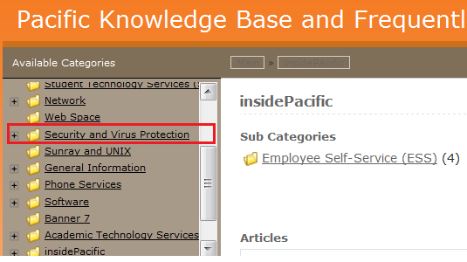
Pacific Resources: InsidePacifc
Administrative Tab
Go to Help Tab
Follow links to Security and Virus Protection

Slide 19
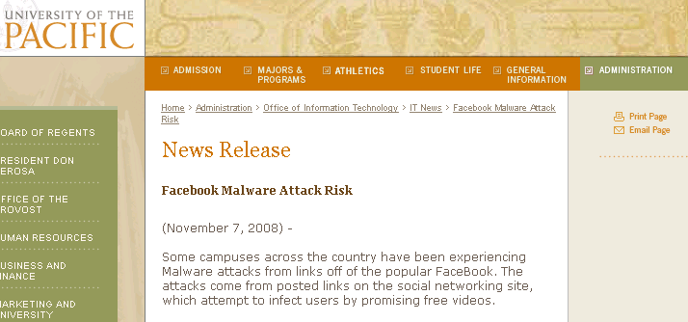
Pacific Resources
News Release: Facebook risk

Slide 20
Safeguard your privacy
Review what you have posted online periodically.
  Hints to your passwords
  Personal information
  Pictures that can be simply copied and used elsewhere.
One fifth of hiring managers have used the internet to search for personal info on job candidates
Monster Ideas for Employers

